Slide 1
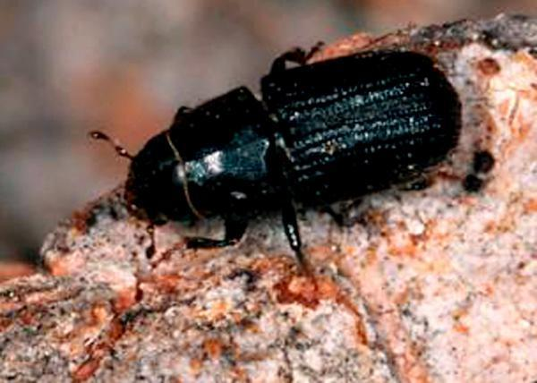
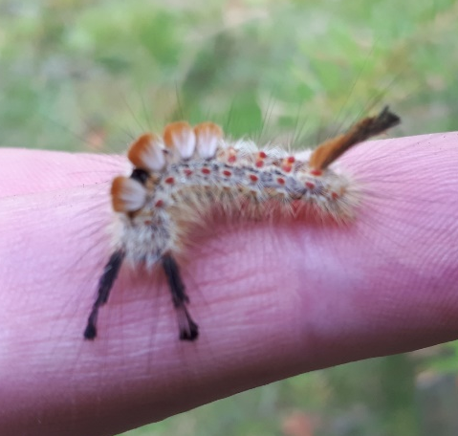
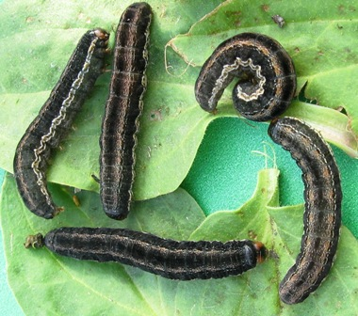
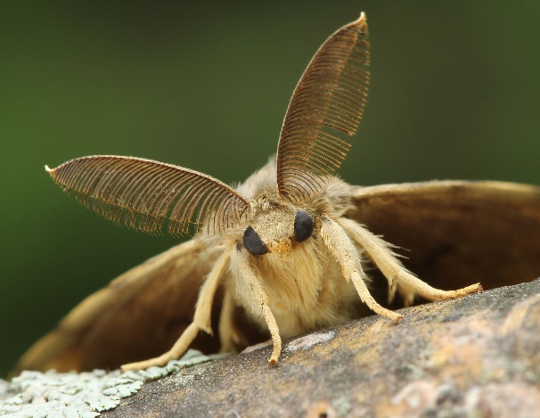
Boundary Woodlot Association
Winter Meeting
January 11, 2020
Marnie Duthie-Holt
Regional Entomologist

Slide 2
Overview
Drought
Bark beetles Douglas-fir beetle
Western Balsam bark beetle
Defoliators Western spruce budworm
Douglas-fir tussock moth
Invasives Gypsy moth

Slide 3
Drought
ha
Boundary TSA – heaviest hit

Slide 4
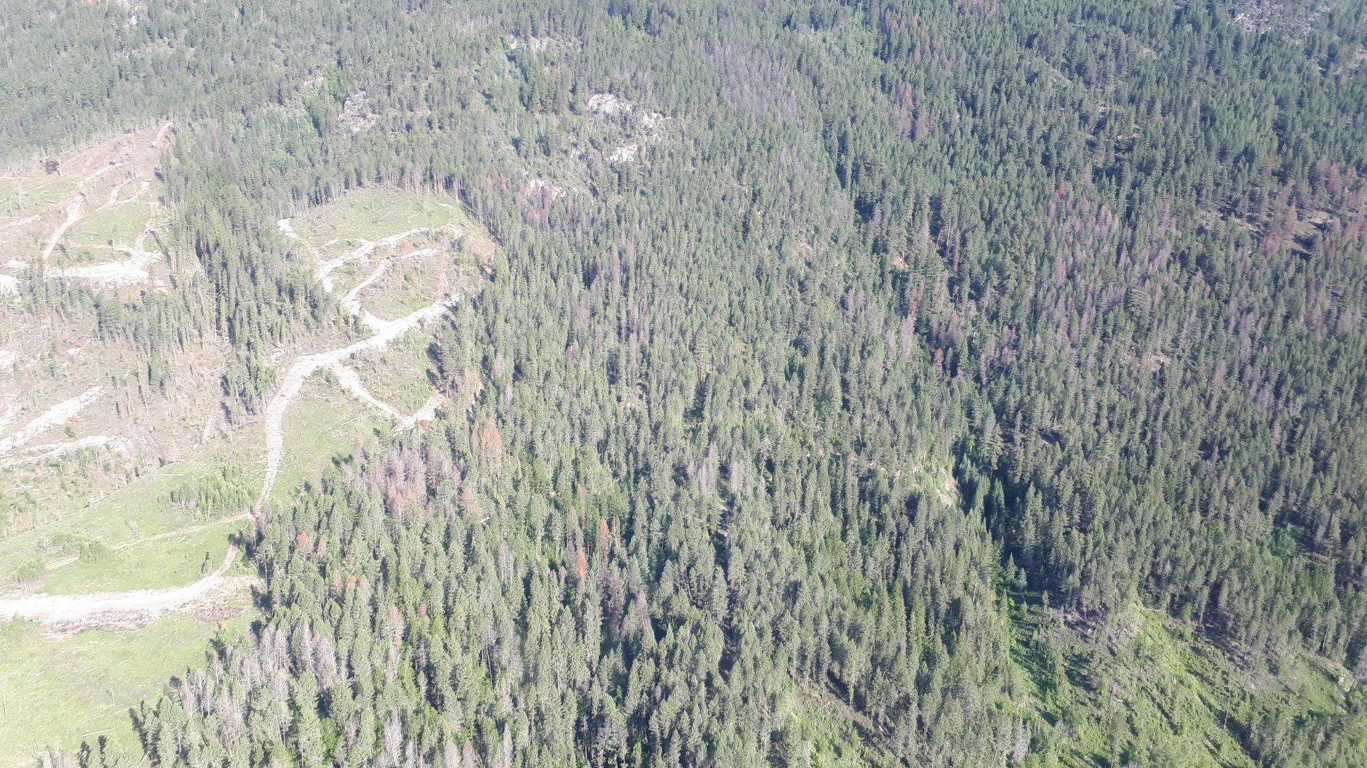
Drought
“Hot droughts”
low precipitation & high temperatures
Direct impacts;
  reduced growth,
  crown die­‐back,
  mortality;
Indirect impacts
  decreased resistance to insect and disease attack
Bark beetles, engraver beetles, and weevils are particularly sensitive to drought conditions with populations increasing!

Slide 5
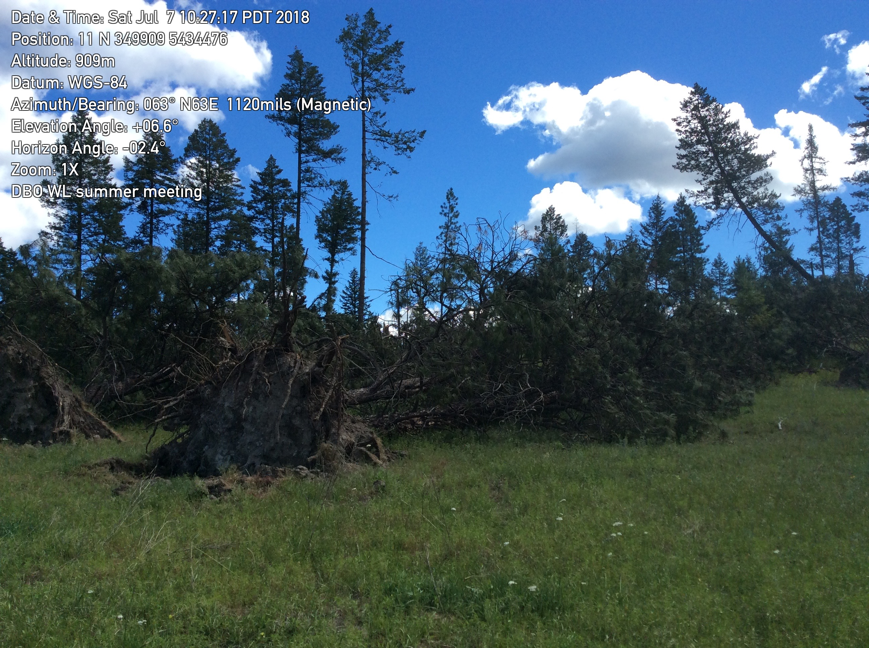
Favorable Habitat
Population Buildup
Favorable Weather
Outbreak in Living Trees
Overmature Forest
Susceptible Host
Trees Under Stress

Slide 6
Douglas-fir beetle over the last decade 2010-2019

Slide 7
Douglas-fir beetle in Boundary over last decade
Blowdown event June 2018

Slide 8
Management Techniques for Douglas-fir beetle
Sanitation harvesting
Felled trap trees
Pheromone baiting standing trees
Falling and burning of infested trees
Timely burning of susceptible slash piles
Anti-aggregation pheromones (MCH)
Baited funnel traps

Slide 9
Baited Funnel Traps
PROS
Don’t become saturated like trap trees/ baited trees = unlimited capacity
Fully infested TT or baited trees can become source of anti-aggregation – spill over attack
TT/ Baited trees – females can re-emerge = SISTER flight – can’t in funnel traps
No disposal of infested trees
For ever 1,700 beetles caught = save a tree
CONS
Capital cost to purchase
High risk of spill-over attack to standing trees if placed too near (within 100m)
High maintenance (bears, wind, cows, hunters)
High labour to monitor and maintain (traps must be checked & emptied regularly)
Also catch predators (clerids)
Vapona

Slide 10
Lethal Funnel Trapping - experiment
Choose 30 sites in Boundary
10 for each treatment; Syngery lite, WestGreen and unbaited
3 trap clusters, placed 5-10m apart, within 50 meter opening
choose moderate-high hazard stands (large, old Fd stands)
Use 12mm clerid mesh to keep out predators
Set-up mid-March/ early April
Monitor collect trap catches, label in ziplock bags and freeze
bi-weekly April-May, weekly June-July, bi-weekly Aug
Rebait in June
Deal with any spill over attack

Slide 11
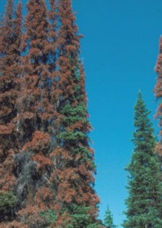
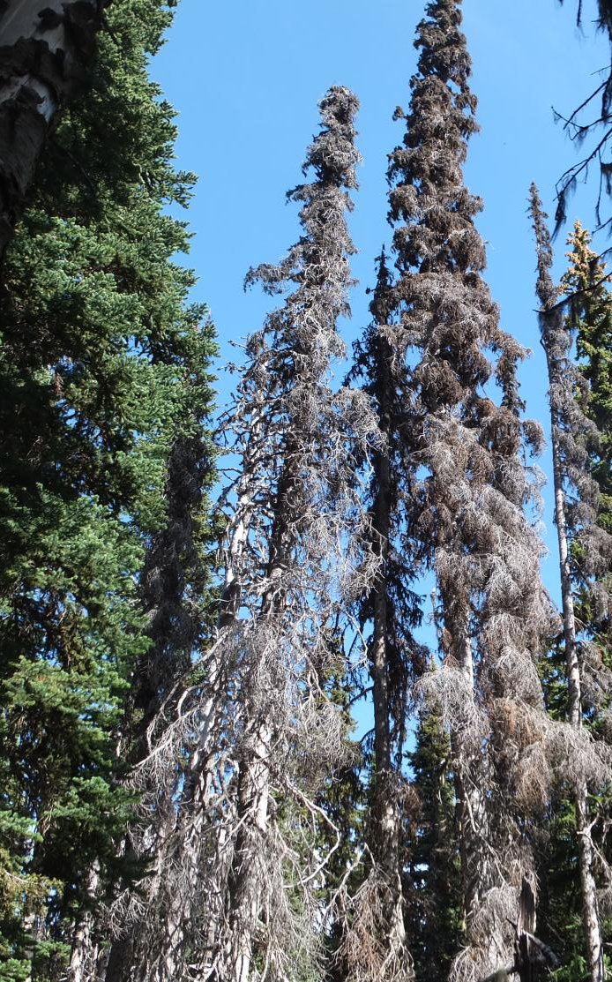
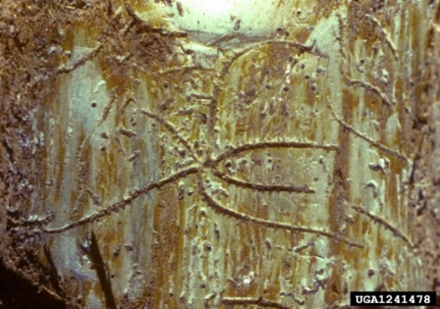
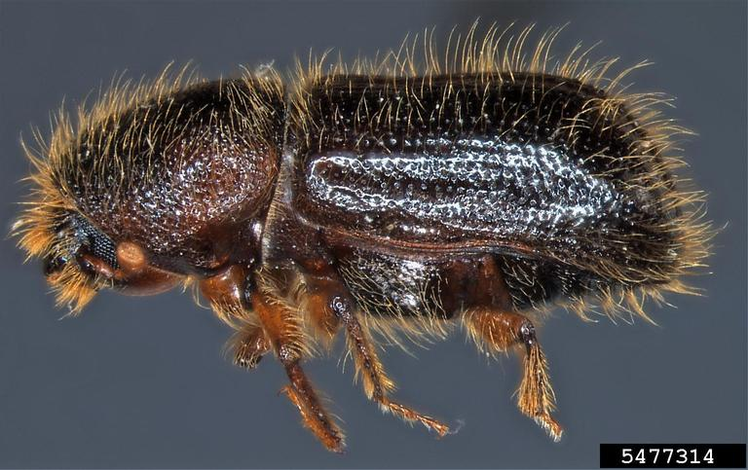
Western balsam bark beetle
Attack rates are accelerating
Very little Bl is being salvaged, therefore few impacted stands rehabilated
Climate change repercussions in these high elevation forest much more drastic

Slide 12
Historical trends & current issues
Western Balsam Bark Beetle
KBR ha total | 2019 | Last 10 years
IBB | 100,000 | 316,000
IBM | 25,000 | 407,400
IBS | 20,000 | 65,000
IBD | 12,000 | 40,000

Slide 13
Western Balsam Bark Beetle
Boundary

Slide 14
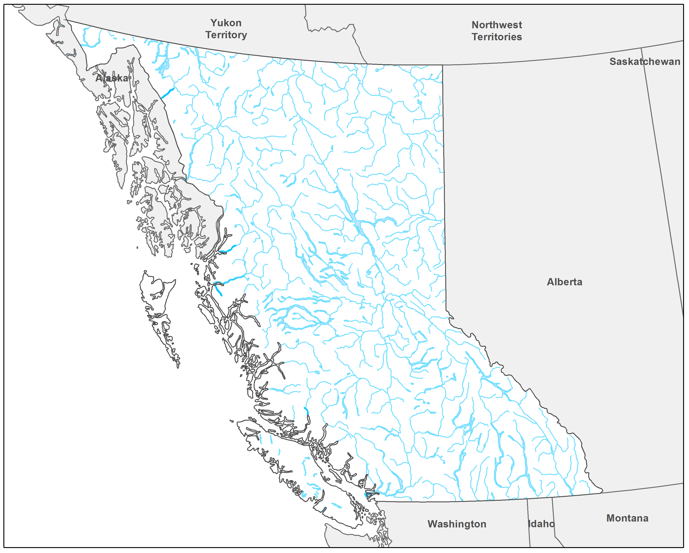
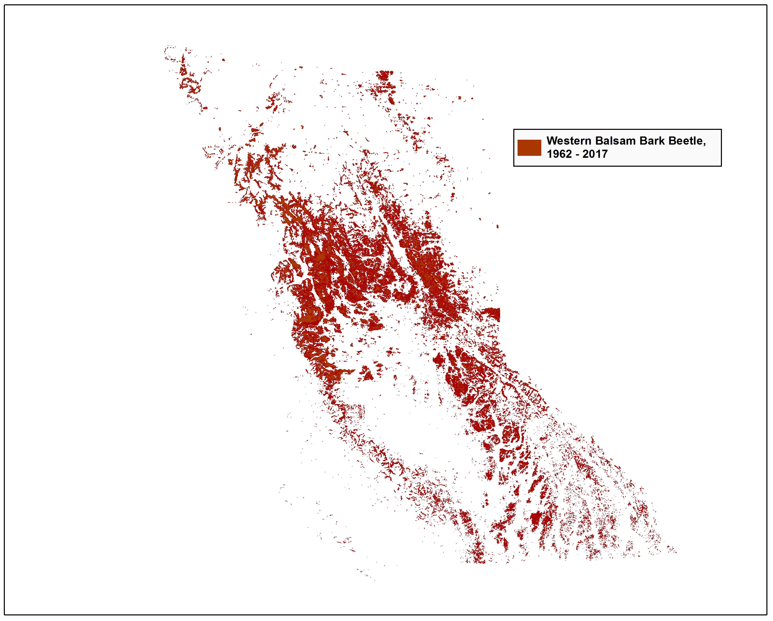
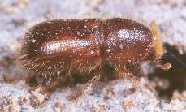

Slide 15
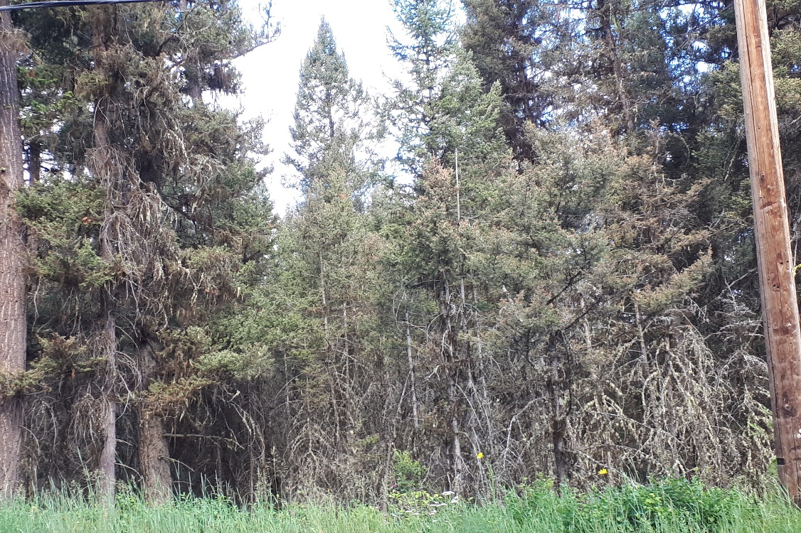
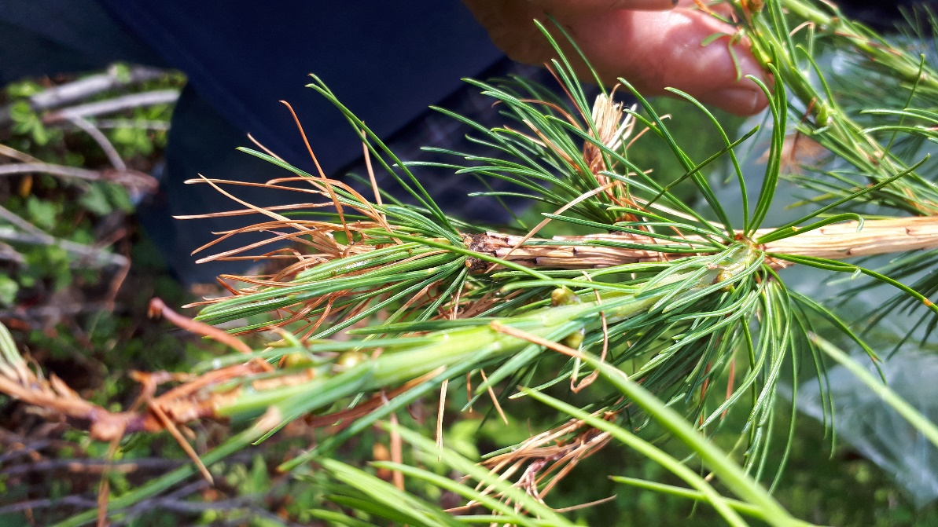
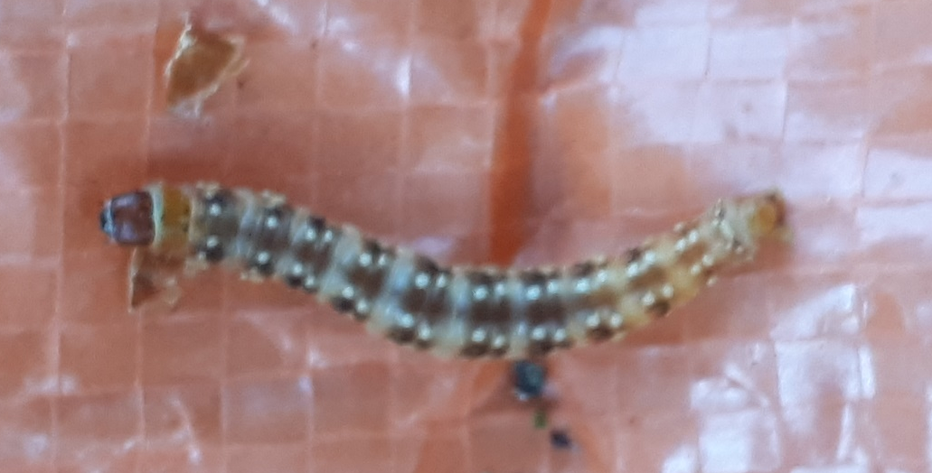
Western Spruce Budworm
  Reduces incremental growth, kills tree after multiple years
  Understory most effected
  Decision to spray B.t.k. based on;
  Aerial Overview Surveys (AOS)
  Egg mass sampling
  Larval sampling
  TOR and CAR Spraying in 2020
  Numbers still too low to spray in KBR, will continue to monitor

Slide 16
1. AOS - Western Spruce Budworm
Boundary
2019 = 133 ha

Slide 17
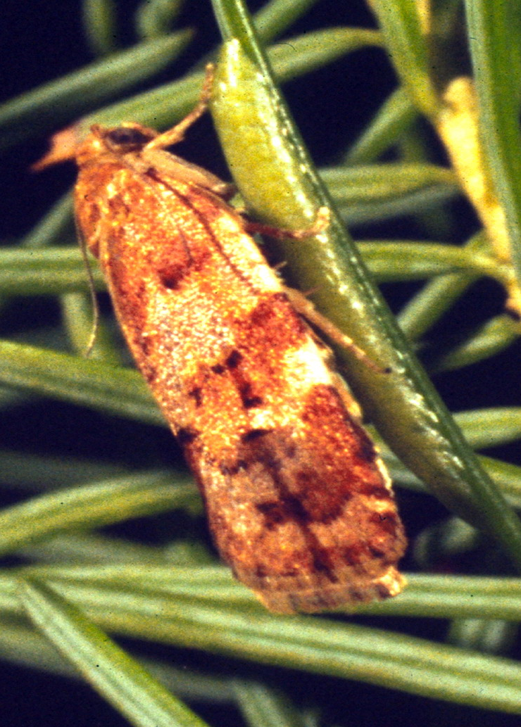
1. Egg Sampling
18 sites
Western Spruce Budworm

Slide 18
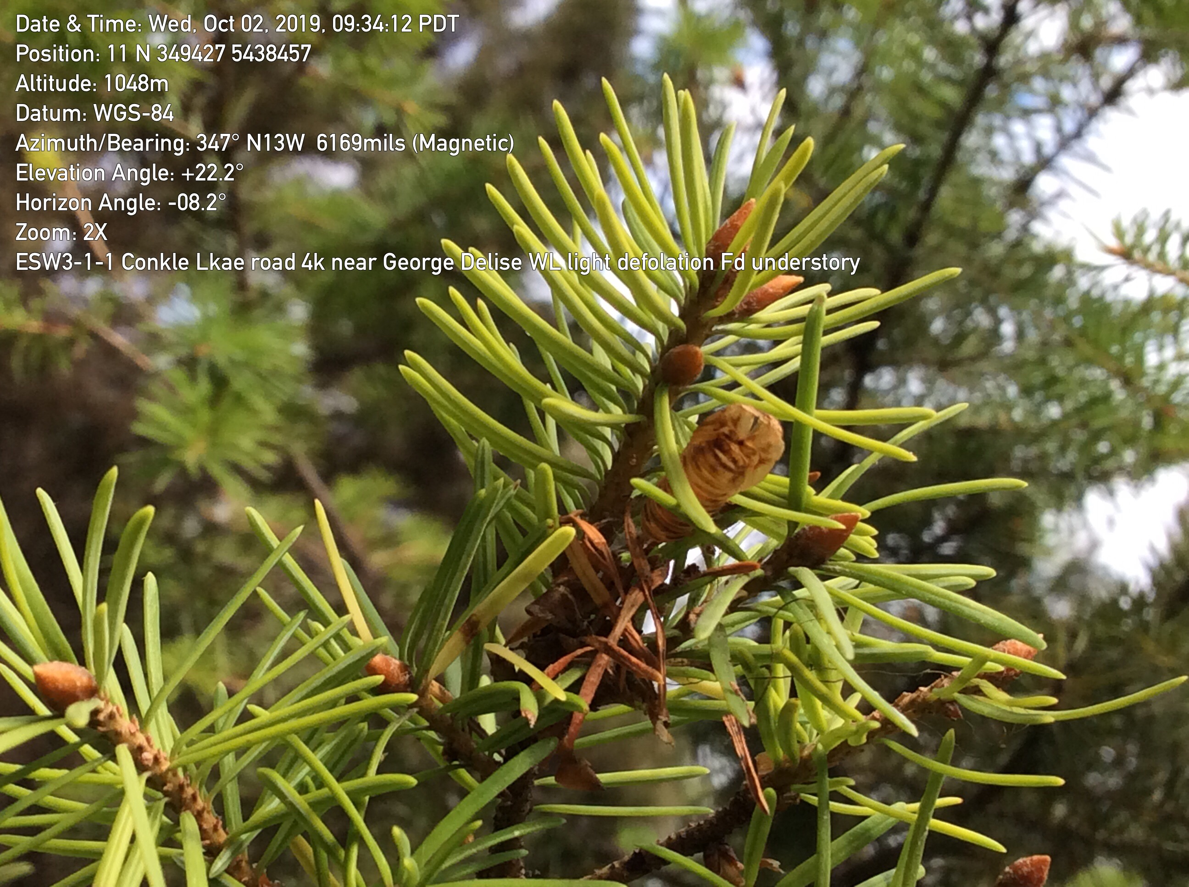
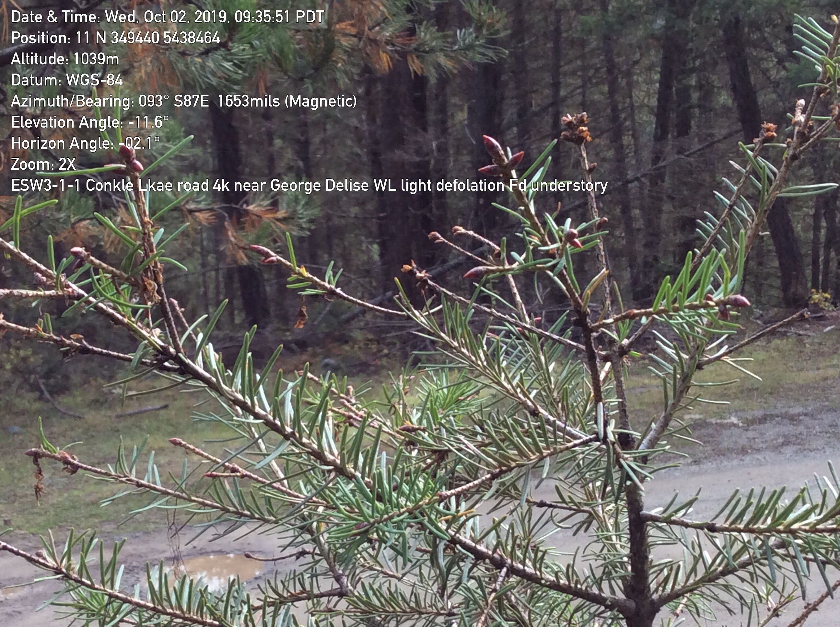
Nil to light defoliation 2019

Slide 19
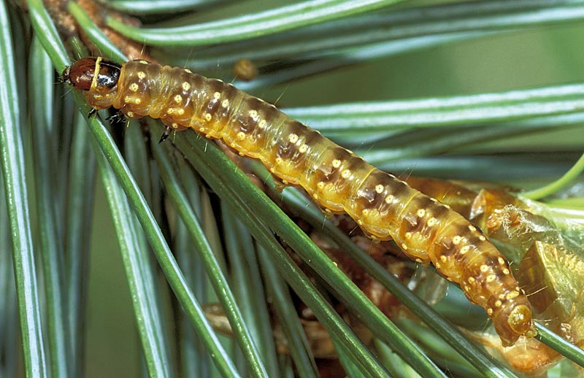
3. Larval sampling
Western Spruce Budworm
-
Only Johnston Creek Road had any larvae 2019

Slide 20
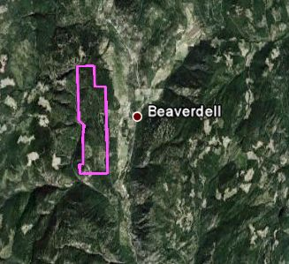
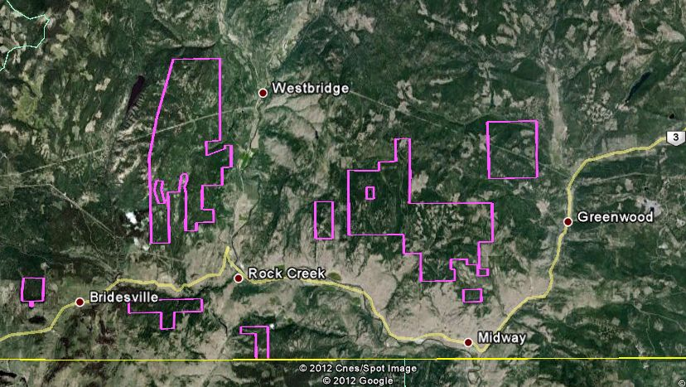
Western Spruce Budworm
  Last spray 2012

Slide 21

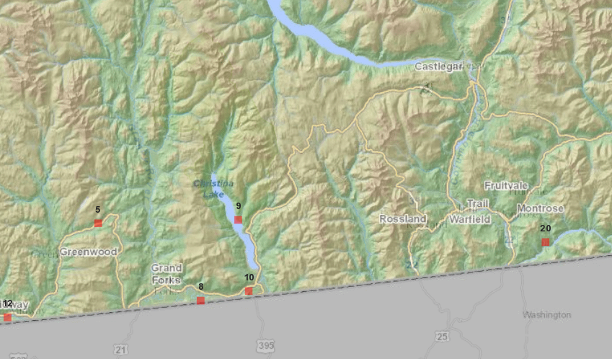
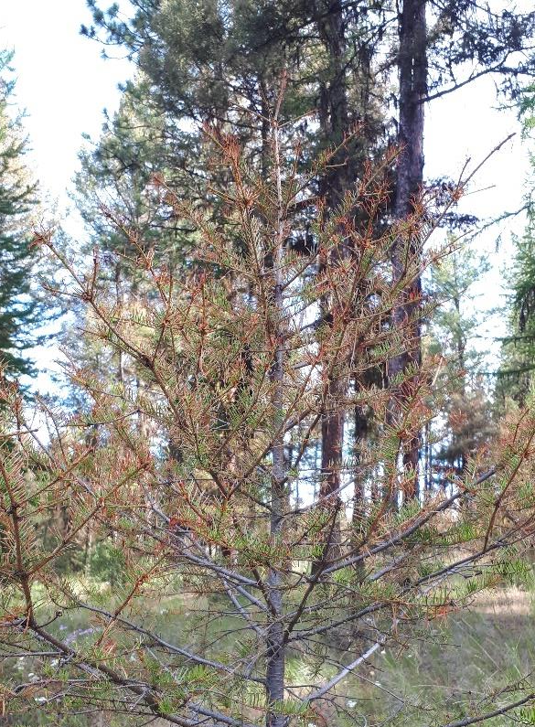
Douglas-fir tussock moth
Outbreaks occur every 8-12 years
Monitored annually by;
  Aerial Overview Surveys
  Larval sampling (3-tree beating)
  6 trap pheromone trap catches in PSPs
When consistent upward trend is noted in a stand for 2-3 years or average of 25 or more moths per trap caught = ground surveys for egg masses recommended – potential spray

Slide 22
Douglas-fir tussock moth
Populations slightly increasing near Rock Creek, east to Greenwood, and in Midway
2019 no larvae found at all 9 PSPs
Historical records: near Grand Forks, Rock Creek, Kettle Valley, Christina Lake and Cascades
On private land
Kills trees in single year
Health concerns –allergic reaction
Will continue to monitor

Slide 23
Douglas-fir tussock moth – adult trap catches (2009-2019)
9 PSPs
Low overall numbers indicate Douglas-fir tussock moth remains at low levels

Slide 24
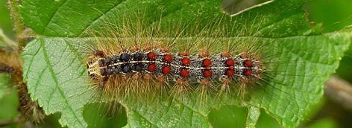

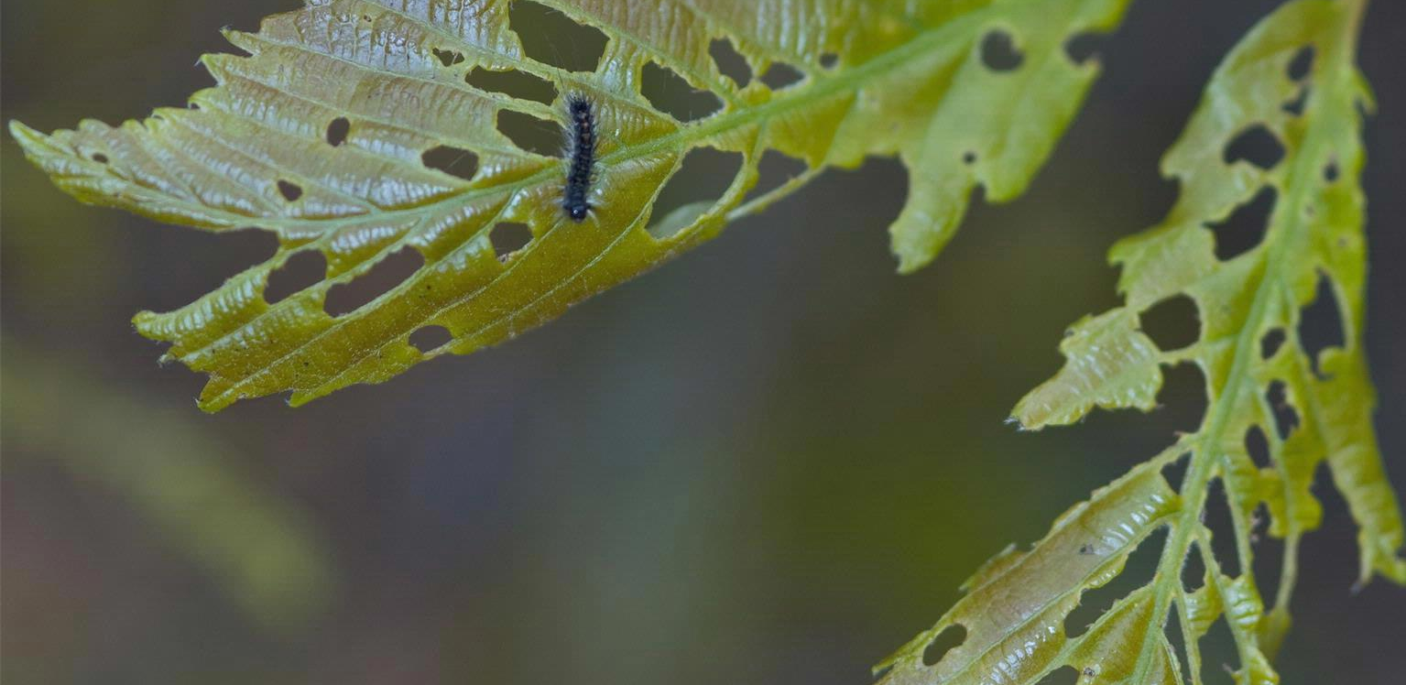
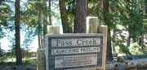
Invasive: Gypsy Moth
One of 100 most destructive invasive species worldwide
Host includes 500 species of deciduous trees, shrubs and plants
BCs highest priority for forest health funding; International trade and export controls require eradication
2020 Btk spray areas:
  Surrey
  Lake Cowichan and
  Castlegar – 14 moths caught 2019 (167 ha)

Slide 25
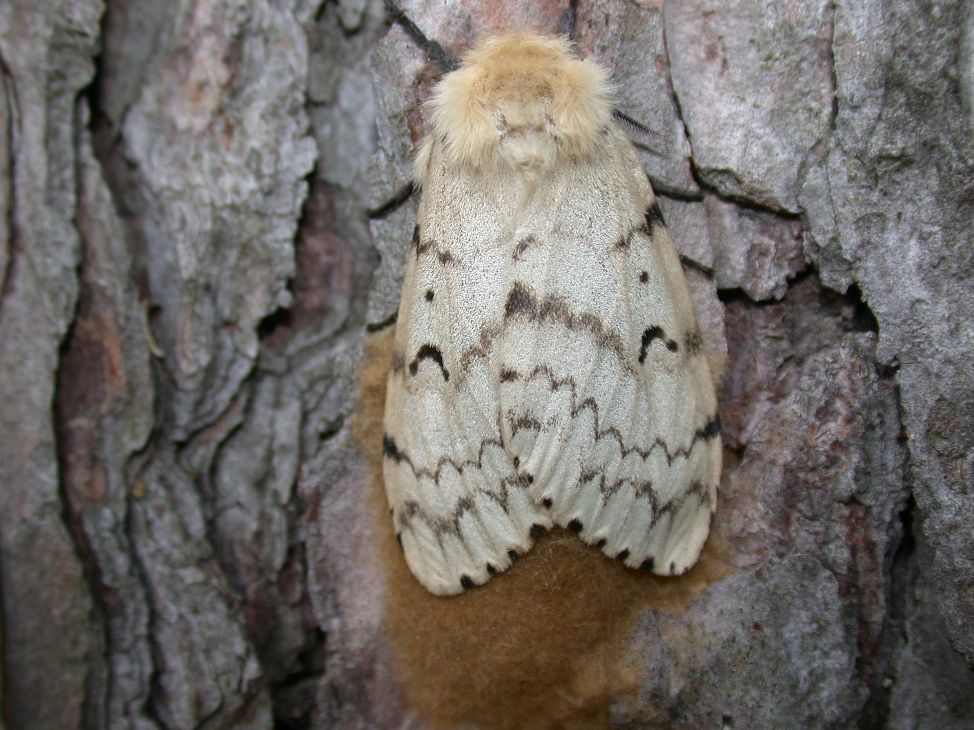
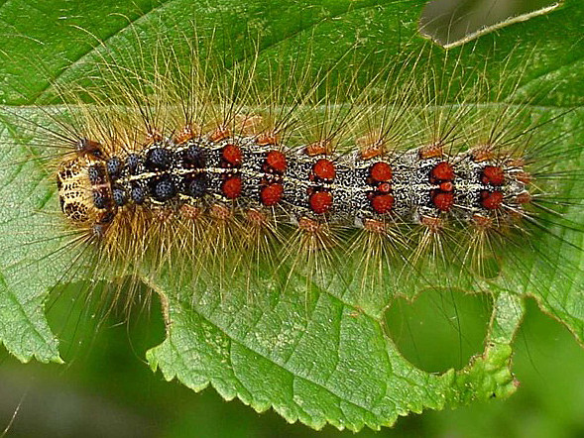
Gypsy Moth Open House
Where: Castlegar and District Community Complex
Kootenay Room, 2102 – 6th Ave.
When: Thursday, January 23, 2020
4:30 to 8:00pm
Who: Ministry Staff, along with members of BC Gypsy Moth Technical Advisory Committee, Ministry of Environment and Climate Change Strategy, Ministry of Agriculture, Canadian Food Inspection Agency, Canadian Forest Service and other experts.

Slide 26
